Slide 1


Medical Insurance Cost
Probability Course - Sekolah Data Pacmann
pacmann.io
© 2022 – Pacmann AI

Slide 2
Outline
Introduction
Dataset
Descriptive Statistic Analysis
Categorical Variables Analysis
Continuous Variables Analysis
Variables Correlation
Hypothesis Testing
Conclusion

Slide 3
Introduction
Notes:
Transisi antar outline

Slide 4
Introduction
This project is performed to fulfill assignment for probability class in pacmann data analyst bootcamp program
This project also performed to improve data analytical skill with emphasize in probability topic
This project also performed to build portfolio
This project focus on the analysis of treatment cost of policyholder with the emphasize in probability.

Slide 5
Dataset
Notes:
Transisi antar outline

Slide 6
Dataset
The dataset used in this project is about the medical costs billed by health insurance which can be affected by many variables, hence this project will focus on determining the significant variables which affect the cost by using various tools.
The column in this datasets includes:
age | age of policyholder
sex | gender of policyholder (female / male)
bmi | body mass index, providing an understanding of body, weights that are relatively high or low relative to height
children | number of children or dependent covered by policyholder
smoker | smoker status of policyholder (yes / no)
region | residential area of the policyholder in the US (northeast / southeast / southwest / northwest)
charges | policyholder’s medical costs billed by health insurance

Slide 7
Descriptive Statistics Analysis
Notes:
Transisi antar outline

Slide 8
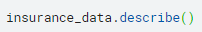
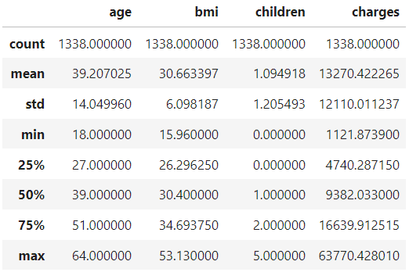
General Mean & Median
Mean and Median of the column with numerical values can be obtained using pandas describe function.
Result:
The charges mean value is higher than its median, which indicates the existence of top outlier

Slide 9
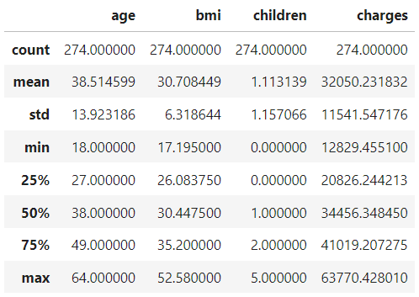
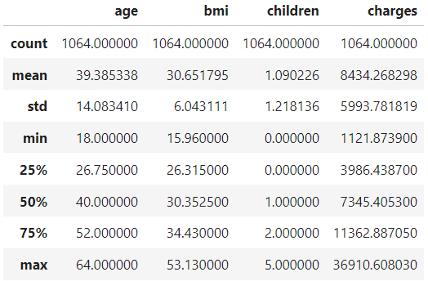
Mean & Median Based on Smoker Status
Smoker Policyholder | Nonsmoker Policyholder
The charges mean value of smoker is lower than its median, which indicates the existence of bottom outlier
The charges mean value of nonsmoker is higher than its median, which indicates the existence of top outlier
There is a huge difference between mean and median value of charges of smoker and nonsmoker, in which the smoker is higher

Slide 10
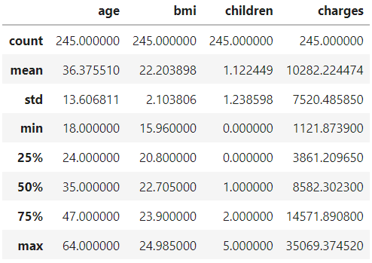
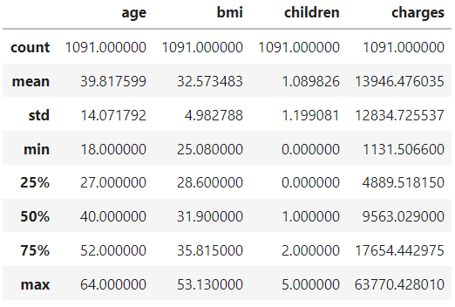
Mean & Median Based on BMI
BMI < 25 Policyholder | BMI > 25 Policyholder
The charges mean value of BMI <25 and >25 is higher than its median, which indicates the existence of top outlier
Mean and median value of age and charges of policyholder with BMI > 25 is higher compared to BMI < 25
However, the difference is not as big as comparison between smoker and nonsmoker

Slide 11
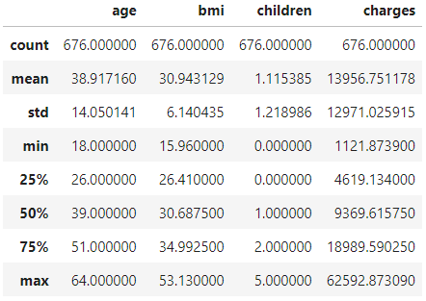
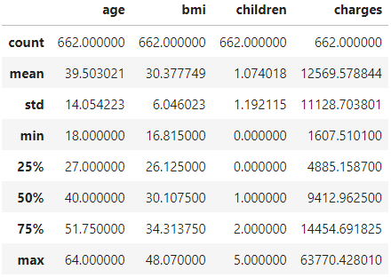
Mean & Median Based on Gender
Male Policyholder | Female Policyholder
The charges mean value of male and female is higher than its median, which indicates the existence of top outlier
Mean of charges of male policyholder is higher than female
However, there is no significant difference on the median of charges between both gender, this finding might indicate that there is either more upper outlier or more extreme outlier in the male sample

Slide 12
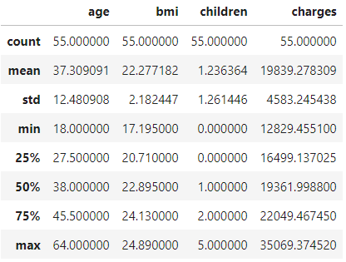
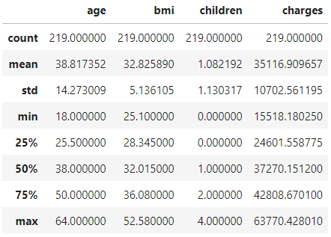
Mean & Median of Smoker Based on BMI
Smoker & BMI < 25 Policyholder | Smoker & BMI > 25 Policyholder
The mean value in Smoker & BMI > 25 Policyholder is lower than its median, which indicates the existence of bottom outlier
Mean and median value of charges of Smoker & BMI > 25 Policyholder is higher compared to Smoker & BMI < 25 Policyholder

Slide 13
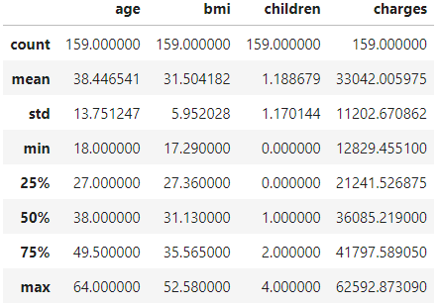
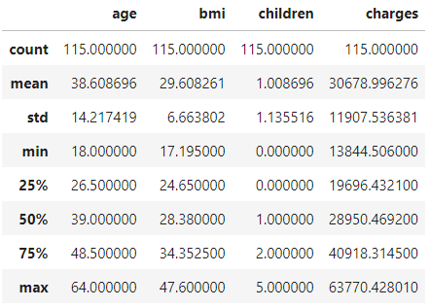
Mean & Median of Smoker Based on Gender
Smoker Male Policyholder | Smoker Female Policyholder
The mean value in Smoker Male Policyholder is lower than its median, which indicates the existence of bottom outlier
The mean value in Smoker Female Policyholder is higher than its median, which indicates the existence of top outlier
Mean and median value of bmi and charges of Smoker Male Policyholder is higher compared to Smoker Female Policyholder

Slide 14
Q&A
What is the average age of policyholders?
39.2
What is the average BMI of smoker policyholders?
30.7
Is the average age of smoker male and female policyholders similar?
Yes, the average age of male and female smoker in sequence is 38.4 and 38.6
Which one is higher, the average charges of smoker or nonsmoker policyholders?
The average charges of smoker policyholders is higher compared to nonsmoker policyholders.
average charges of smoker policyholders = 32,050.23
average charges of nonsmoker policyholders = 8,434.27
Which one is higher, male or female BMI?
The BMI mean and median value of male is higher than female. However the difference is not significant
Gender | BMI Mean | BMI Median
Male | 30.94 | 30.38
Female | 30.69 | 30.11

Slide 15
Analysis
The charges column have outlier
Smoker status have influence on the medical charges amount
BMI have influence on the medical charges amount (lesser influence compared to smoker status)
There is no significant difference in charges between male and female,
However, when comparing male and female smoker, the charges mean and median of male smoker is higher than female smoker. This might caused by difference in variance

Slide 16
Categorical Variables Analysis
Notes:
Transisi antar outline

Slide 17
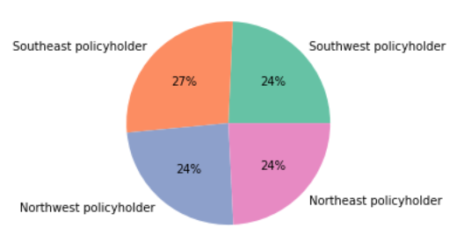
Proportion Analysis: Region
Southwest policyholders amount: 325
Southeast policyholders amount: 364
Northwest policyholders amount: 325
Northeast policyholders amount: 324
The sample proportion per region is almost evenly distributed
Southeast have the highest and most different sample proportion compared to the other three region

Slide 18
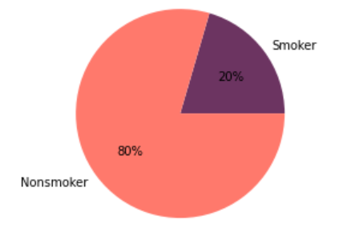
Proportion Analysis: Smoker Status
Smoker policyholders amount: 274
Nonsmoker policyholders amount: 1064
The sample proportion of nonsmoker is higher than smoker

Slide 19
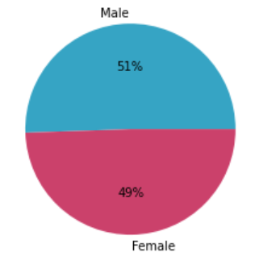
Proportion Analysis: Gender
Male policyholders amount: 676
Female policyholders amount: 662
The sample proportion by gender is almost evenly distributed
Male policyholders sample proportion is higher than female

Slide 20
Q&A
Which gender have higher charges?
Mean of charges of male policyholder is higher than female.
However, there is no significant difference on the median of charges between both gender, this finding might indicate that there is either more upper outlier or more extreme outlier in the male sample
In conclusion, there is no significant difference between male and female charges
Does each region have the same sample proportion?
The sample proportion per region is almost evenly distributed.
Southeast have the highest sample proportion which is 27% compared to the other three region which is 24%.
Which one is higher, proportion of smokers or nonsmokers?
The sample proportion of nonsmoker is higher than smoker

Slide 21
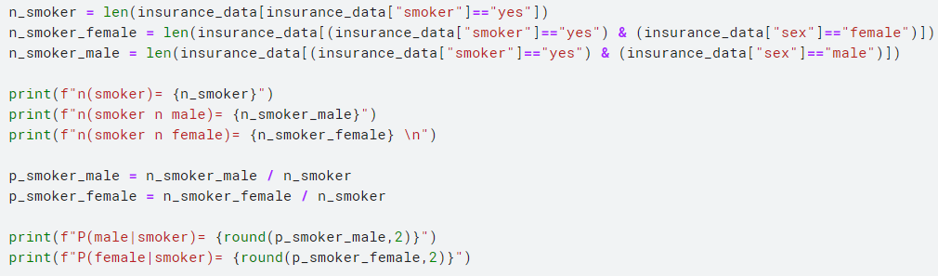
Q&A
What is the probability of male policyholder if he known to be a smoker
What is the probability of female policyholder if she known to be a smoker
n (smoker) = 274
n (smoker ⋂ male) = 159
n (smoker ⋂ female) = 115
P (male | smoker) = 0.58
P (female | smoker) = 0.42

Slide 22
Analysis
Region and gender have pretty balanced sample proportion
Smoker status is very unbalanced and heavily distributed toward nonsmoker, this might cause a difference in variance value between both samples
A smoker policyholders is more likely to be a male than a female. However, the difference is minor.

Slide 23
Continuous Variables Analysis
Notes:
Transisi antar outline

Slide 24
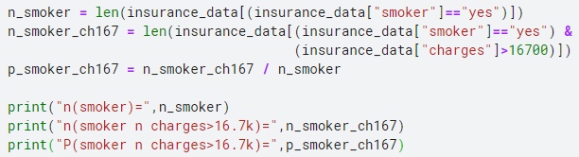
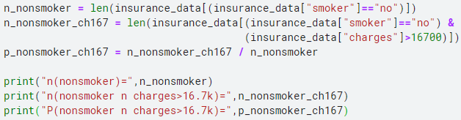
Q&A
Which one is more likely to happen between the two condition below:
Smoker policyholders to have medical charges above 16.7k (Q3) | Nonsmoker policyholders to have medical charges above 16.7k (Q3)
n(smoker)= 274 n(smoker ⋂ charges>16.7k)= 254 P(smoker ⋂ charges>16.7k)= 0.93 | n(nonsmoker)= 1064 n(nonsmoker ⋂ charges>16.7k)= 80 P(nonsmoker ⋂ charges>16.7k)= 0.08
Policyholder who is a smoker is more likely to have medical charges above 16.7k compared to nonsmoker

Slide 25
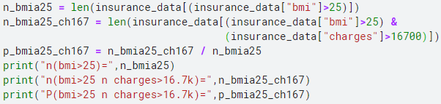
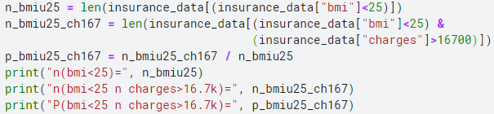
Q&A
Which one is more likely to happen between the two condition below:
Policyholders with BMI above 25 to have medical charges above 16.7k | Policyholders with BMI below 25 to have medical charges above 16.7k
n(bmi>25)= 1091 n(bmi>25 ⋂ charges>16.7k)= 283 P(bmi>25 ⋂ charges>16.7k)= 0.26 | n(bmi<25)= 245 n(bmi<25 ⋂ charges>16.7k)= 51 P(bmi<25 ⋂ charges>16.7k)= 0.21
Policyholders who have BMI >25 is more likely to have medical charges above 16.7k compared to those with BMI <25

Slide 26
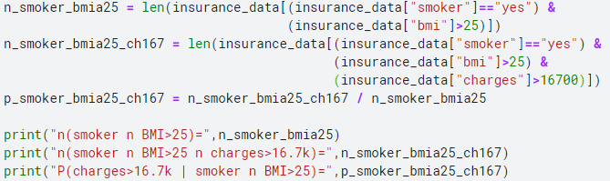
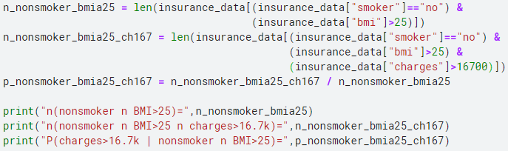
Q&A
Which one is more likely to happen between the two condition below:
Policyholders who is a smoker with BMI above 25 to have medical charges above 16.7k | Policyholders who is a nonsmoker with BMI above 25 to have medical charges above 16.7k
n(smoker ⋂ BMI>25)= 219 n(smoker ⋂ BMI>25 ⋂ charges>16.7k)= 215 P(charges>16.7k | smoker ⋂ BMI>25)= 0.98 | n(nonsmoker ⋂ BMI>25)= 872 n(nonsmoker ⋂ BMI>25 ⋂ charges>16.7k)= 68 P(charges>16.7k | nonsmoker ⋂ BMI>25)= 0.08
Policyholders who is a smoker with BMI >25 is more likely to have medical charges above 16.7k compared to policyholders who is a nonsmoker with BMI >25

Slide 27
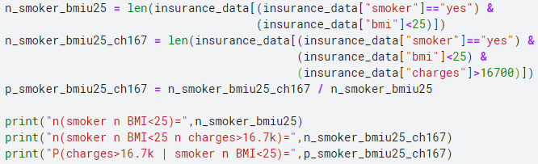
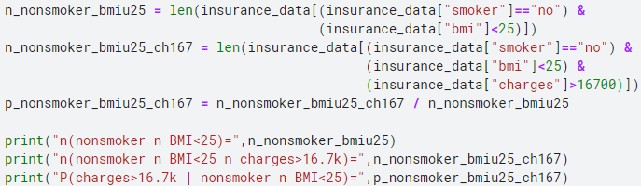
Q&A
Which one is more likely to happen between the two condition below:
Policyholders who is a smoker with BMI below 25 to have medical charges above 16.7k | Policyholders who is a nonsmoker with BMI below 25 to have medical charges above 16.7k
n(smoker ⋂ BMI<25)= 55 n(smoker ⋂ BMI<25 ⋂ charges>16.7k)= 39 P(charges>16.7k | smoker ⋂ BMI<25)= 0.71 | n(nonsmoker ⋂ BMI<25)= 190 n(nonsmoker ⋂ BMI<25 ⋂ charges>16.7k)= 12 P(charges>16.7k | nonsmoker ⋂ BMI<25)= 0.06
Policyholders who is a smoker with BMI <25 is more likely to have medical charges above 16.7k compared to policyholders who is a nonsmoker with BMI <25

Slide 28
Probability to have medical charges above 16.7k (Q3)
 | BMI > 25 | BMI < 25
Smokers | 0.98 | 0.71
Nonsmokers | 0.08 | 0.06
Smoker status have higher influence in determining if the value of charges is above the 3rd quartile (16.7k).

Slide 29
Analysis
93% of smoker policyholders have their charges above the 3rd quartile (16.7k)
8% nonsmoker policyholders have their charges above the 3rd quartile (16.7k)
BMI value does not have significant influence on determining if the charges is above the 3rd quartile (16.7k)
Smoker status have significant influence in determining if the value of charges is above the 3rd quartile (16.7k)

Slide 30
Variables Correlation
Notes:
Transisi antar outline

Slide 31
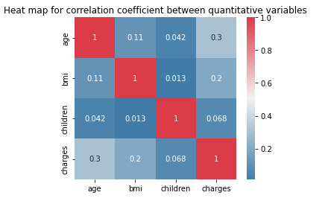
Correlation between numerical variables
To find pearson correlation coefficient between numerical variables, we can use pandas and seaborn
Based on the correlation coefficient value between age and charges have the highest correlation which is 0.3 (positive) and followed by BMI and charges with correlation coefficient value of 0.2 (positive).

Slide 32
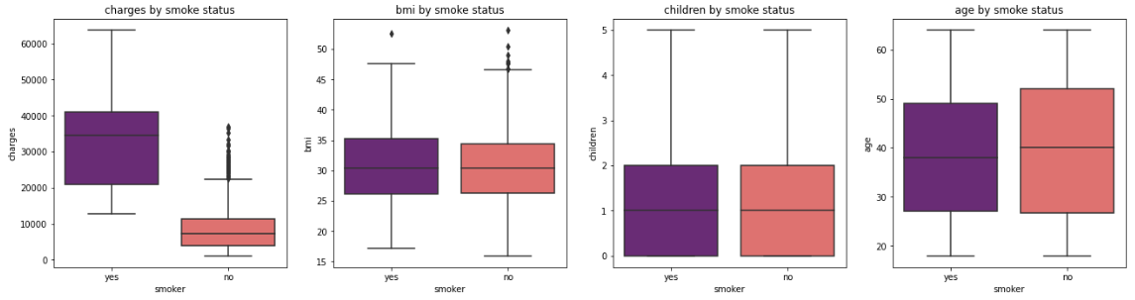
Correlation between numerical and categorical variables
To find correlation between numerical with categorical variables, we can observe using boxplot
Smoker have incurred more insurance charges than nonsmoker.

Slide 33
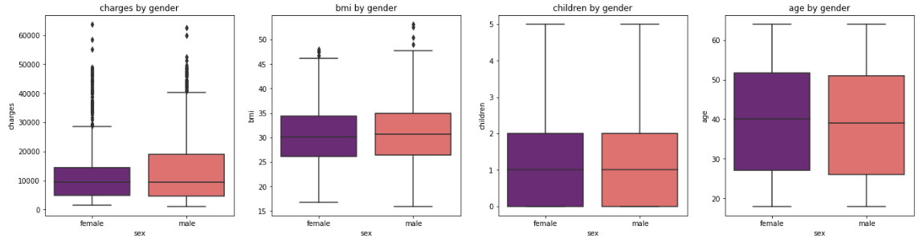
Correlation between numerical with categorical variables
Male policyholder has higher 3rd quartile compared to female policyholder

Slide 34
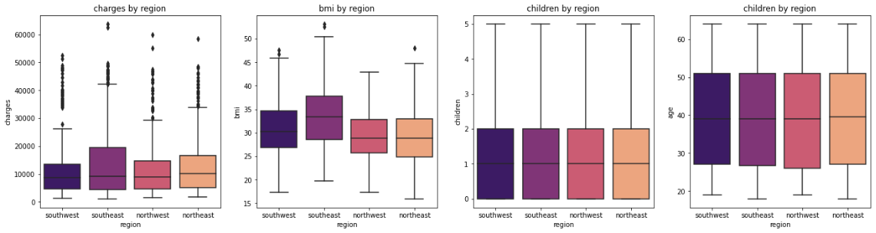
Correlation between numerical with categorical variables
Average BMI from southeast higher compared to other regions
Charges incurred from southeast is higher compared to other regions

Slide 35
Correlation between categorical variables
To find correlation between categorical variables, we can use chi square independency test
Based on the chi square independency test perform in python using scipy, below are the results:
independency test sex-smoker
p value is 0.006548143503580696
Dependent (reject H0)
independency test region-smoker
p value is 0.06171954839170541
Independent (H0 holds true)
independency test region-sex
p value is 0.9328921288772233
Independent (H0 holds true)
Based on the chi square independency test, there is a correlation between gender and smoker status

Slide 36
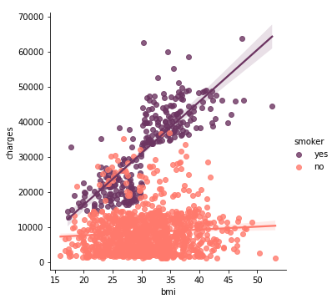
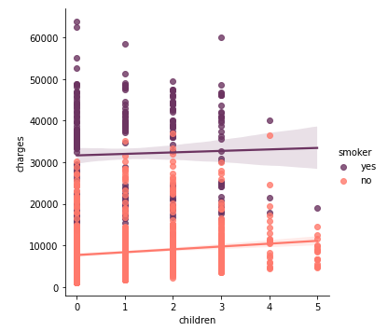
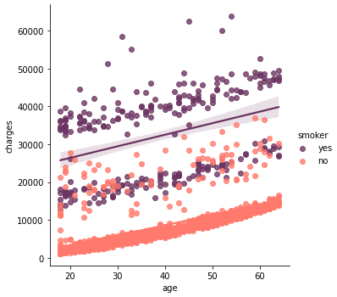
Multivariate Analysis
To avoid confounding bias due to smoker status, multivariate analysis will be performed using seaborn lmplot
Both in smoker and nonsmoker group, age have positive correlation with charges (no bias)
Smoker status affect the correlation between BMI and charges, in which the correlation increase significantly with smoker status
The smoker status have no significant influence on the correlation between charges and children

Slide 37
Analysis
On the numerical variables, age and charges have the highest correlation which is 0.3 (positive) and followed by BMI and charges with correlation coefficient value of 0.2 (positive).
Smoker have correlation with charges as the distribution of charges of smoker is higher than nonsmoker
Based on the chi square independency test, there is a correlation between gender and smoker status
Correlation between BMI and charges increase significantly with smoker status

Slide 38
Hypothesis Testing
Notes:
Transisi antar outline

Slide 39
Hypothesis testing: The medical charges of policyholder who smoke is greater than those who don't
Define null and alternate hypothesis:
H0: μ1 ≤ μ2 The average charges of smokers is less than or equal to nonsmokers
H1: μ1 > μ2 The average charges of smokers is greater than nonsmokers
Decide the significance level
α = 0.05
Identify the test:
As standard deviation of the population is not known, T stat test would be appropriate.
The > sign in alternate hypothesis indicate test is right tailed

Slide 40
Hypothesis testing: The medical charges of policyholder who smoke is greater than those who don't
Sample:
no. of smoker sample: 274
no. of nonsmoker sample: 1064
As the sample size of smoker is unequal with nonsmoker, bartlett test are performed to ensure the variances are equal for all samples:
H0: The variances are equal for all samples
H1: The variances are not equal for one pair or more
α = 0.05
Bartlett Result:
p value is 5.06089742139399e-52
The variances are not equal (reject H0)
As the test shows that the variances are not equal, the hypothesis testing mother that will be used is Welch t-test
Welch’s t-test result:
one-tail p-value = 2.94473222335849e-103
The average charges of smokers is greater than nonsmokers (reject H0)

Slide 41
Hypothesis testing: The medical charges of policyholder with BMI value above 25 is higher than those with BMI value under 25
Define null and alternate hypothesis:
H0: μ1 ≤ μ2 The average charges of policyholder with BMI above 25 is less than or equal to those with BMI value under 25
H1: μ1 > μ2 The average charges of policyholder with BMI above 25 is greater than those with BMI value under 25
Decide the significance level
α = 0.05
Identify the test:
As standard deviation of the population is not known, T stat test would be appropriate.
The > sign in alternate hypothesis indicate test is right tailed

Slide 42
Hypothesis testing: The medical charges of policyholder with BMI value above 25 is higher than those with BMI value under 25
Sample:
no. of BMI above 25: 1091
no. of BMI under 25: 245
As the sample size is unequal, bartlett test are performed to ensure the variances are equal for all samples:
H0: The variances are equal for all samples
H1: The variances are not equal for one pair or more
α = 0.05
Bartlett Result:
p value is 2.3532085528057478e-21
The variances are not equal (reject H0)
As the test shows that the variances are not equal, the hypothesis testing mother that will be used is Welch t-test
Welch’s t-test result:
One-tail p-value = 2.540448651580689e-09
The average charges of policyholder with BMI above 25 is greater than those with BMI value under 25 (reject H0)

Slide 43
Hypothesis testing: The medical charges of male is higher than female
Define null and alternate hypothesis:
H0: μ1 ≤ μ2 The average charges of male is less than or equal to female
H1: μ1 > μ2 The average charges of male is greater than female
Decide the significance level
α = 0.05
Identify the test:
As standard deviation of the population is not known, T stat test would be appropriate.
The > sign in alternate hypothesis indicate test is right tailed

Slide 44
Hypothesis testing: The medical charges of male is higher than female
Sample:
no. of male: 676
no. of female 662
As the sample size is unequal, bartlett test are performed to ensure the variances are equal for all samples:
H0: The variances are equal for all samples
H1: The variances are not equal for one pair or more
α = 0.05
Bartlett Result:
p value is 7.886776680290195e-05
The variances are not equal (reject H0)
As the test shows that the variances are not equal, the hypothesis testing mother that will be used is Welch t-test
Welch’s t-test result:
One-tail p-value = 0.017920507478008323
The average charges of male is greater than female (reject H0)

Slide 45
Conclusion
Notes:
Transisi antar outline

Slide 46
Conclusion
Based on the analysis performed, several variables have significant effect on the value of medical charges of an policyholder. These variables include:
BMI
Age
Smoker Status
Gender
A person with high BMI value are more prone to diseases, which might cause higher medical charges
Gender have effect on the value of charges, in which males have higher charges compared to female. However, the difference between both gender is small
Age have effect on the value of charges, as older people are more prone to diseases.
Smoker status have big impact on the value of charges
In addition smoker status can increase the effect of BMI and age to the value of charges
Several variables have influence on the medical charges amount. However, the only controllable variables are BMI and smoker status. Thus, the insurance provider should focus on these two variables in order to push down the aggregate medical charges.

Slide 47
Notes
Make other version with EDA approach
Add more hypothesis testing

Slide 48
Reference
https://www.geeksforgeeks.org/welchs-t-test-in-python/
Pacmann Module

